Slide 1
DIFFUSION TENSOR IMAGING
Marija Cauchi and Kenji Yamamoto

Slide 2
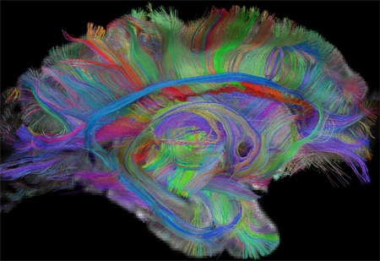
Overview
Introduction
Pulse gradient spin echo
ADC/DWI
Diffusion tensor
Diffusion tensor matrix
Tractography

Slide 3
DTI
Non invasive way of understanding brain structural connectivity
Macroscopic axonal organization
Contrast based on the directional rate of diffusion of water molecules

Slide 4
DTI
WATER protons = signal in DTI
Diffusion property of water molecules (D)
D = diffusion constant
Move by Brownian motion / Random thermal motion
Image intensities inversely related to the relative mobility of water molecules in tissue and the direction of the motion

Slide 5
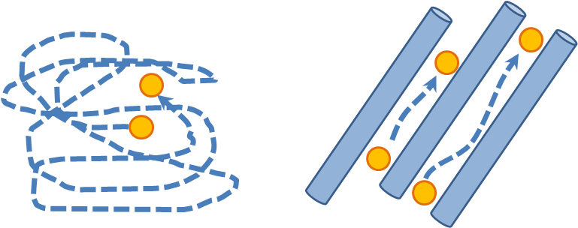
Brownian motion of water molecule
Rosenbloom et al

Slide 6
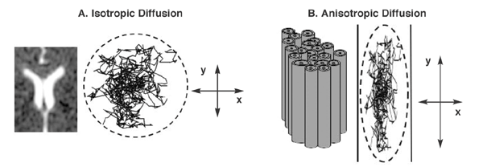
DIFFUSION

Slide 7
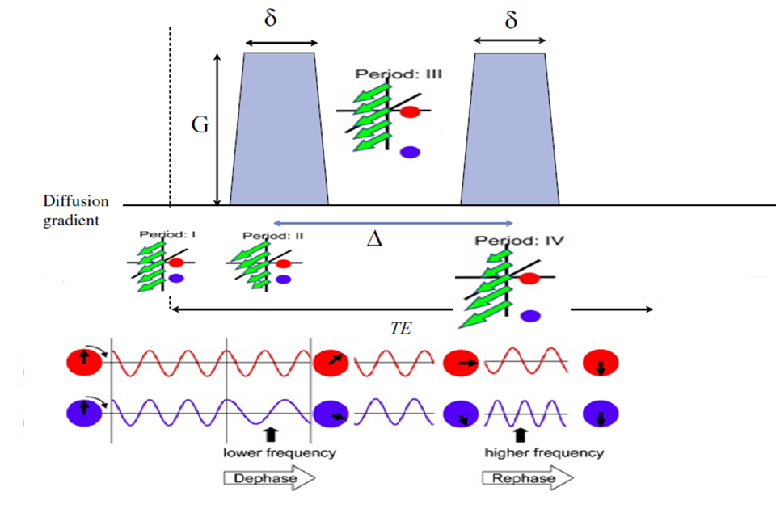
Pulsed Gradient Spin-echo

Slide 8
ω = ϒ B
ω = angular frequency
ϒ = gyromagnetic ratio
B = (B₀ + G * distance) = magnitude of the magnetic field

Slide 9
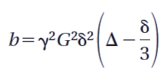

What is b?
b-value gives the degree of diffusion weighting and is related to the strength and duration of the pulse gradient as well as the interval between the gradients
b changes by lengthening the separation of the 2 gradient pulses more time for water molecules to move around more signal loss (imperfect rephasing)
G= gradient amplitude
δ = duration
= trailing to leading edge separation

Slide 10
Apparent Diffusion Coefficient
ADC – less barriers
ADC - more barriers


S
ln(S)




b-value
b-value

Slide 11
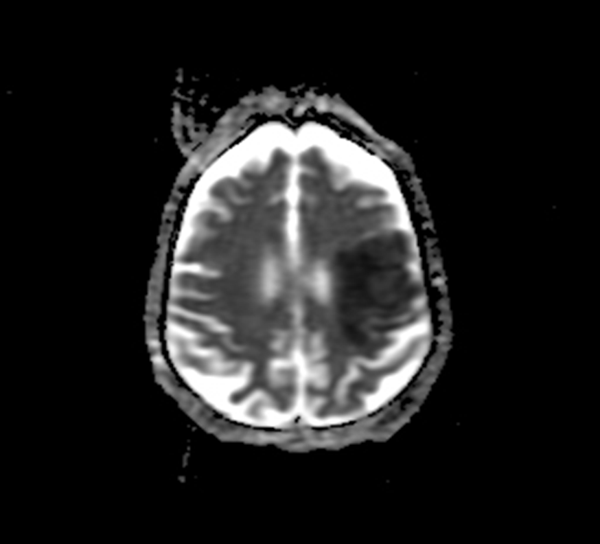
ADC
Dark regions – water diffusing slower – more obstacles to movement OR increased viscosity
Bright regions – water diffusing faster
Intensity of pixels proportional to extent of diffusion
Left MCA stroke:
www.radiopaedia.org

Slide 12
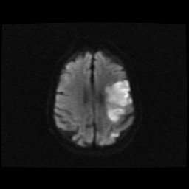
DWI
Bright regions – decreased water diffusion
Dark regions – increased water diffusion
www.radiopaedia.org

Slide 13
DWI
ADC
Hygino da Cruz Jr, Neurology 2008

Slide 14
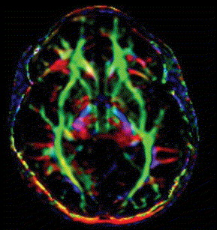
Colour FA map
Colour coding of the diffusion data according to the principal direction of diffusion
red - transverse axis (x-axis)
blue – superior-inferior (z -axis)
green – anterior-posterior axis (y-axis)
Intensity of the colour is proportional to the fractional anisotropy

Slide 15
Water diffusion in brain tissue
Depends upon the environment:
Proportion of intracellular vs extracellular water: cytotoxic vs vasogenic oedema
Extracellular structures/large molecules particularly in disease states
- Physical orientation of tissue e.g.nerve fibre direction

Slide 16
Diffusion anisotropy
Diffusion is greater in the axis parallel to the orientation of the nerve fibre
Diffusion is less in the axis perpendicular to the nerve fibre

Slide 17
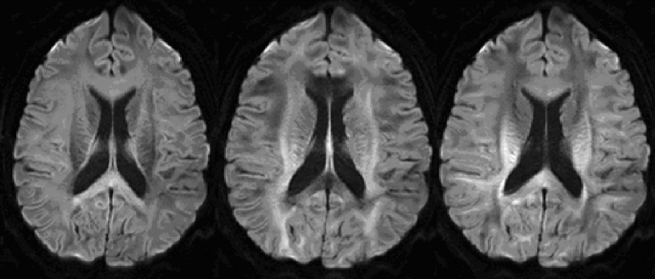
Effect of Varying Gradient direction
DWI z DWI x DWI y

Slide 18
What is the diffusion tensor?
In the case of anisotropic diffusion: we fit a model to describe our data: TENSOR MODEL
- This characterises diffusion in which the displacement of water molecules per unit time is not the same in all directions

Slide 19
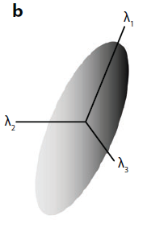
What is the diffusion tensor?
Johansen-Berg et al.
Ann Rev. Neurosci 32:75-94 (2009)

Slide 20
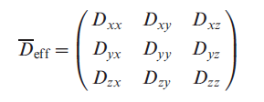
What is the diffusion tensor matrix?
This is a 3 x 3 symmetrical matrix which characterises the displacement in three dimensions :

Slide 21
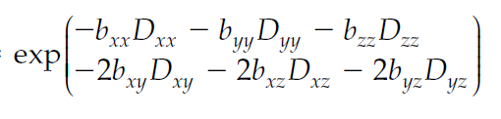
The Tensor Matrix
S = S₀e^{(-bD)}
For a single diffusion coefficient, signal=
For the tensor matrix=
(-b_{xx}D_{xx}-2b_{xy}D_{xy}-2b_{xz}D_{xz}-b_{yy}D_{yy}-2b_{yz}D_{yz}-b_{zz}D_{zz})
S = S₀e
S/S₀ =

Slide 22
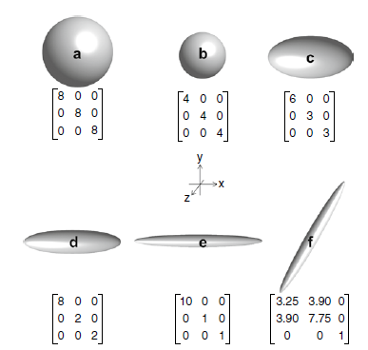
`Diffusion MRI`
Johansen-Berg and Behrens

Slide 23
Eigenvectors and Eigenvalues
The tensor matrix and the ellipsoid can be described by the:
Size of the principles axes = Eigenvalue
Direction of the principles axes = Eigenvector
These are represented by

Slide 24

The Tensor Matrix
λ1, λ2 and λ3 are termed the diagonal values of the tensor
λ1 indicates the value of maximum diffusivity or primary eigenvalue (longitudinal diffusivity)
λ2 and λ3 represent the magnitude of diffusion in a plane transverse to the primary one (radial diffusivity) and they are also linked to eigenvectors that are orthogonal to the primary one

Slide 25
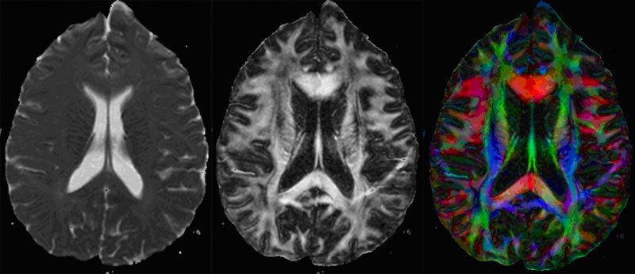
Indices of Diffusion
Simplest method is the MEAN DIFFUSIVITY (MD):
λ₁+λ₂+λ₃
MD = <λ> =
3
This is equivalent to the orientationally averaged mean diffusivity

Slide 26
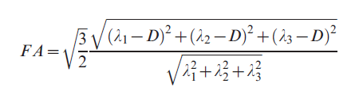
Indices of Anisotropic Diffusion
Fractional anisotropy (FA):
    The calculated FA value ranges from 0 – 1 :
FA= 0 → Diffusion is spherical (i.e. isotropic)
FA= 1 → Diffusion is tubular (i.e. anisotropic)

Slide 27
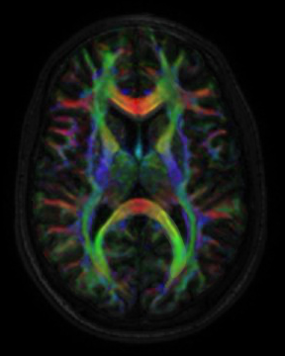
Colour FA Map
Demonstrates the direction of fibres

Slide 28
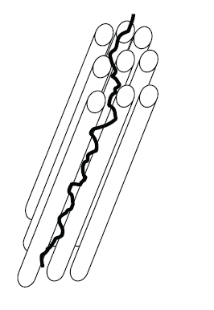
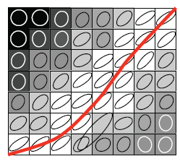
Tractography - Overview
Not actually a measure of individual axons, rather the data extracted from the imaging data is used to infer where fibre tracts are
Voxels are connected based upon similarities in the maximum diffusion direction
Johansen-Berg et al.
Ann Rev. Neurosci 32:75-94 (2009)

Slide 29
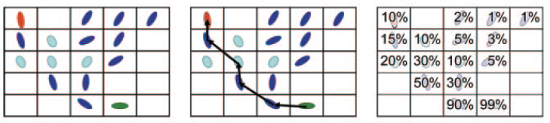
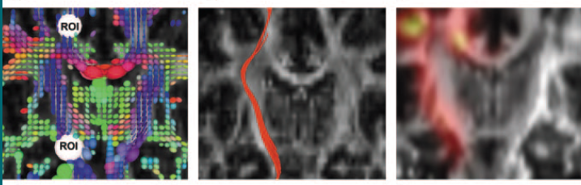
Tractography – Techniques
Degree of anisotropy Streamline tractography Probabilistic tractography
Nucifora et al. Radiology 245:2 (2007)

Slide 30
Streamline (deterministic) tractography
Connects neighbouring voxels from user defined voxels (SEED REGIONS) e.g. M1 for the CST
User can define regions to restrict the output of a tract e.g. internal capsule for the CST
Tracts are traced until termination criteria are met (e.g. anisotropy drops below a certain level or there is an abrupt angulation)

Slide 31
Probabilistic tractography
Value of each voxel in the map = the probability the voxel is included in the diffusion path between the ROIs
Run streamlines for each voxel in the seed ROI
Provides quantitative probability of connection at each voxel
Allows tracking into regions where there is low anisotropy e.g. crossing or kissing fibres

Slide 32
Crossing/Kissing fibres
Crossing fibres
Kissing fibres
Low FA within the voxels of intersection

Slide 33
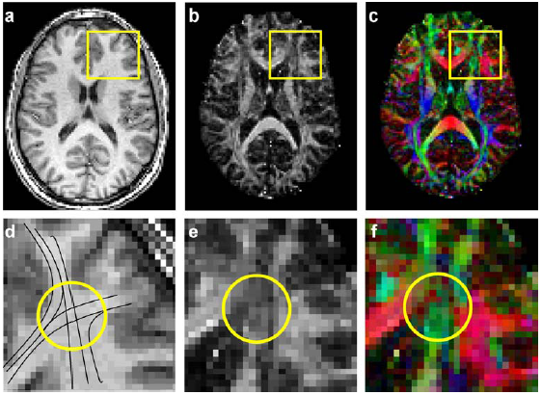
Crossing/Kissing fibres
Assaf et al
J Mol Neurosci 34(1) 51-61 (2008)

Slide 34
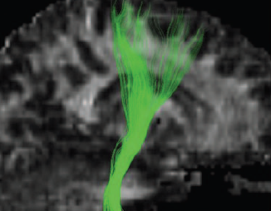
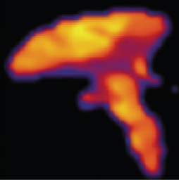
DTI - Tracts
Corticospinal Tracts - Streamline
Corticospinal Tracts -Probabilistic
Nucifora et al. Radiology 245:2 (2007)

